Slide 1
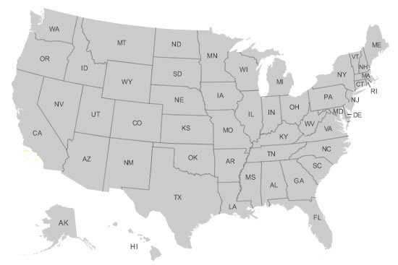
Maps

Slide 2
Why are maps important?

Slide 3
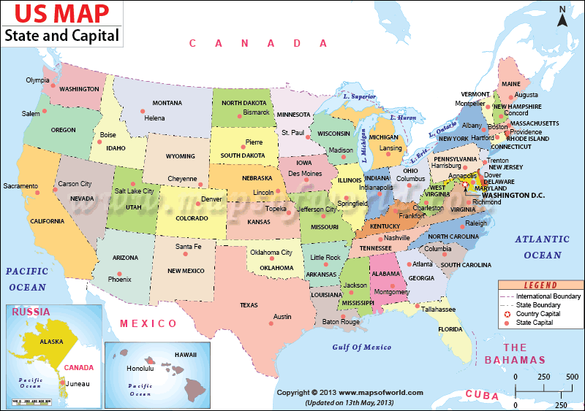
Important things to have on a map
Title
Key/Legend
Scale
Compass Rose

Slide 4
Now its your turn….
Were going to make a map of the classroom.
Draw to the best of your ability.
Make sure to include important parts of the classroom.
Desks, Mrs. Churchill’s desk, book shelves, zen zone, etc.
Label only what you have to. Put the rest in your key.
Notes:
Scale isn’t really important in a map like this but just make sure everything is proportional. Students desks aren’t huge and teachers desk is tiny. Scale it right.

